Slide 1
Machine Learning Algorithms for Lending Risk
Lin Jia Shiqi Li Spencer You Mo Zou

Slide 2
HOW TO SPEND MONEY

Slide 3
Lending Club is the largest online credit marketplace that facilitates personal and business loans
Monthly Payments
Borrowers
Investors
Invest

Slide 4


Lending Club has difficulties attracting investors for several reasons
Increasing loan delinquency rate
Lack of interest alignment
Choice overloaded interface
Notes:
References:
https://www.lendingclub.com/site/investing/solid-returns

Slide 5

Project Objective
Predict the risk of different loans
Maximize profits for both investors and Lending Club
Develop interfaces to filter loans with predictions

Slide 6
Project Overview
Risk
Preprocessing
Machine Learning
Data Exploration
Profit
Financial Analysis
App
Data Visualization

Slide 7
Data Exploration
1
Spencer

Slide 8
Historical loan data from 2012-2013 was used for analysis
We used a historical dataset of Lending Club from 2012-2013, with 100,000+ rows and 98 variables.
BORROWER
Location
Annual income
Employment
Home type
Total Account #
FINANCE
DTI ratio
FICO score
Delinquency
Revolving ratio
Bankruptcy
LOAN
Loan amount
Term
Interest rate
Grade
Purpose
Notes:
References:
https://www.lendingclub.com/site/investing/solid-returns

Slide 9
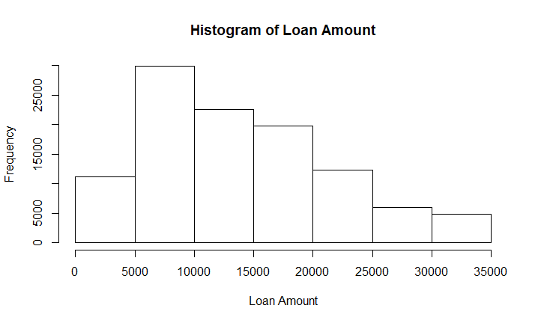
Most of the loan amount on Lending Club is from $5000 to $25000.
The median loan amount is $12720 and the mean loan amount is $14520.

Slide 10
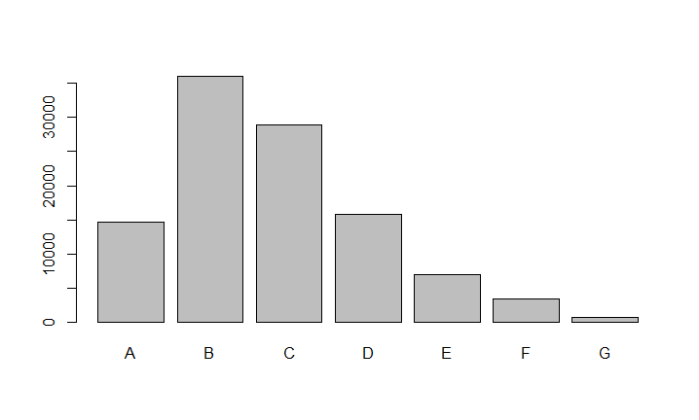
Interest rate increases as loan grade decreases
Grade | A | B | C | D | E | F | G
Interest Rate | 5.32%~ 7.97% | 9.44%~ 11.99% | 12.62%~16.02% | 17.09%~21.45% | 22.91%~26.30% | 28.72%~30.75% | 30.79%~30.99%
Notes:
Use box plot instead for loan grade + interest rate
Y-axis, frequency

Slide 11
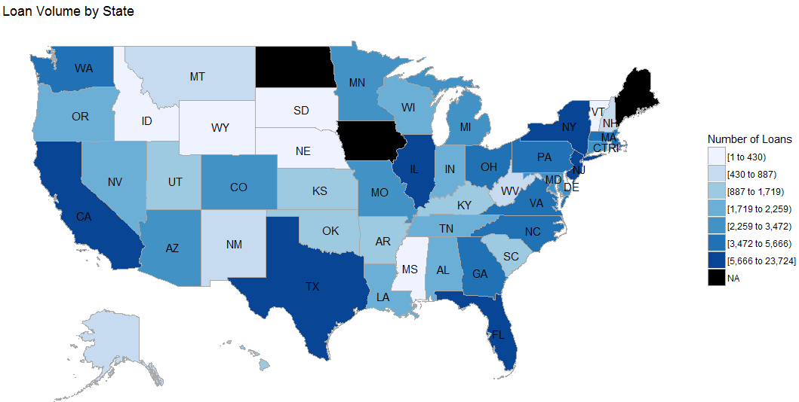
The loans on Lending Club are not evenly distributed geographically

Slide 12
Data Pre-processing
2
Lin

Slide 13
The original dataset is organized but messy
We used a historical dataset of Lending Club from 2012-2013, with 100,000+ rows and 98 variables.
Independent Variables
Dependent Variables
BORROWER
Location
Annual income
Employment
Home type
Total Account #
FINANCE
DTI ratio
FICO score
Delinquency
Revolving ratio
Bankruptcy
LOAN
Loan amount
Term
Interest rate
Grade
Purpose
LOAN STATUS
0: Bad scenario
1: Good scenario
Notes:
References:
https://www.lendingclub.com/site/investing/solid-returns

Slide 14
We did feature transformations to serve for the models
Problem | Methodology | Example
Missing values | Delete rows/columns | Home ownership; Verification
Multiple classes | Transfer to binary variables | Loan Status
Repetitive features | Find the business insights and transform them into one | Average FICO score
Notes:
References:
https://www.lendingclub.com/site/investing/solid-returns

Slide 15
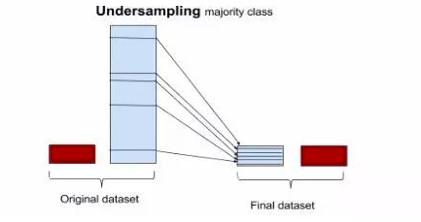
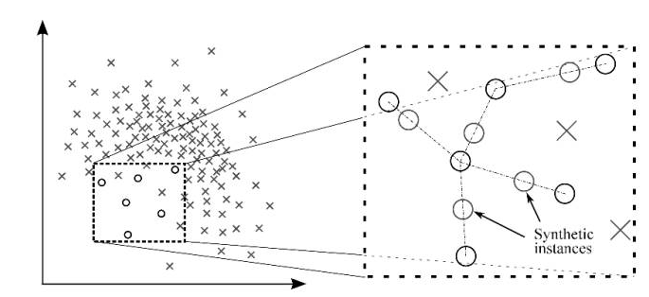
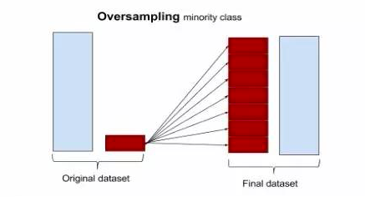
SMOTE is used to solve imbalance problem in y variable
IMBALANCE Problem should be solved!
# (loan_status=1) : # (loan_status=0) = 5:1
SMOTE Synthetic Minority Over-sampling Technique
Undersampling
+
Oversampling
Notes:
References:
https://www.lendingclub.com/site/investing/solid-returns

Slide 16
We design two metrics to evaluate the models’ performance
ACCURACY Is the ratio of correct predictions over total predictions on the test dataset.
$$Accuracy=\frac{TP+TN}{TP+TN+FP+FN}=\frac{Correct Predictions}{Total Predictions}$$
AUC Is the Area Under ROC Curve and ROC is the curve of TP rate and FP rate.
Notes:
References:
https://www.lendingclub.com/site/investing/solid-returns

Slide 17
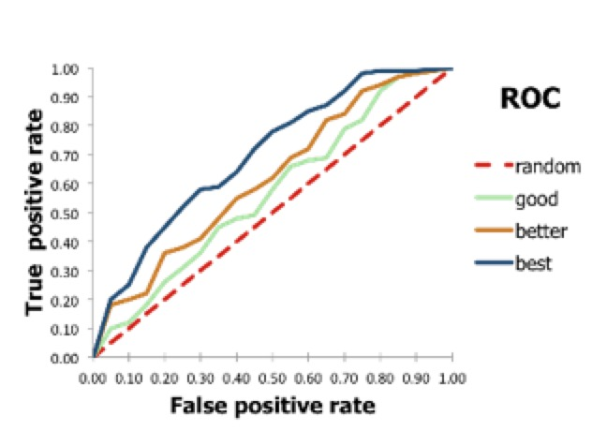
We design two metrics to evaluate the models’ performance
ACCURACY Is the ratio of correct predictions over total predictions on the test dataset.
$$Accuracy=\frac{TP+TN}{TP+TN+FP+FN}=\frac{Correct Predictions}{Total Predictions}$$
AUC Is the Area Under ROC Curve and ROC is the curve of TP rate and FP rate.
ACCURACY Method | AUC Method
Straightforward Offers business insights | Multiple cut-off values Insensitive to data imbalance
Notes:
References:
https://www.lendingclub.com/site/investing/solid-returns

Slide 18
Model Training
3
Shiqi

Slide 19
Logistics Regression
 | AUC | Accuracy
Training | 0.76 | 0.70
Testing | 0.68 | 0.62
The logistic model is used to estimate the probability of a binary response based on the predictors
Notes:
The logistic model is used to estimate the probability of a binary response based on the predictors

Slide 20
Logistics Regression
 | AUC | Accuracy
Training | 0.76 | 0.70
Testing | 0.68 | 0.62
Overfitting
The logistic model is used to estimate the probability of a binary response based on the predictors
Notes:
The logistic model is used to estimate the probability of a binary response based on the predictors

Slide 21
Support Vector Machine
 | AUC | Accuracy
Training | 0.65 | 0.67
Testing | 0.62 | 0.63
Find a hyperplane to divide two classes with the largest margin
Notes:
Support Vector Machine attempts to find a hyperplane (A hyperplane in an n-dimensional space is a n-1 dimensional subset of that space that divides the space into two disconnected parts. ) that divides two classes with the largest margin. The support vectors are the points right up against the margin of the decision hyperplane.
cllass

Slide 22
Random Forest
 | AUC | Accuracy
Training | 0.63 | 0.73
Testing | 0.61 | 0.70
Generate bootstrap samples
Train different trees and take average
At each node, choose random subset of features
Notes:
Generate a bootstrap sample of the original data. random sampling with replacement
Train a tree on this sample. At each node, choose random subset of features, and only consider splitting on those features
Given x, take majority for classification and average for regression
WHY random forest only select a subset of feature? 1. computational efficiency. 2. Improve accuracy. If we always consider all features, some features will

Slide 23
Gradient Boosting is selected as our model
 | AUC | Accuracy
Training | 0.71 | 0.79
Testing | 0.68 | 0.75
Correct its errors iteratively by learning to predict the residual
Notes:
Learn a simple predictor. And then try to correct its errors iteratively by learning to predict the residual.

Slide 24
Top 11 Features based on their contributions
Cut-off = 0.5
 | Actual 0 | Actual 1
Predict 0 | 3070 | 8297
Predict 1 | 4637 | 35280
Notes:
The number of inquiries in past 6 months (excluding auto and mortgage inquiries)

Slide 25
Financial Analysis
4
Shiqi

Slide 26
Cost Benefit Analysis
Assumptions
1. Our model is highly conservative to consider the worst scenario
2. Before our project, investor groups will invest all the loans posted on Lending Club
3. After our project, investor groups will invest the loans predicted to be a good loan
Notes:
References:
https://www.lendingclub.com/site/investing/solid-returns

Slide 27
Cost Benefit Analysis
Original Profit for Total Investors
 | Actual 0 | Actual 1
Predict 0 | TN | FN
Predict 1 | FP | TP
Total Revenue: (FN+TP)* Interest Rate
Total Cost: TN+FP
Profit for Total Investors After Prediction
Total Revenue: TP* Interest Rate
Total Cost: FP
Notes:
References:
https://www.lendingclub.com/site/investing/solid-returns

Slide 28
Cost Benefit Analysis
Original Profit for Total Investors
 | Actual 0 | Actual 1
Predict 0 | TN | FN
Predict 1 | FP | TP
Total Revenue: (FN+TP)* Interest Rate
Total Cost: TN+FP
Profit for Total Investors After Prediction
Total Revenue: TP* Interest Rate
Total Cost: FP
Objective: Maximize the total profit
Notes:
References:
https://www.lendingclub.com/site/investing/solid-returns

Slide 29
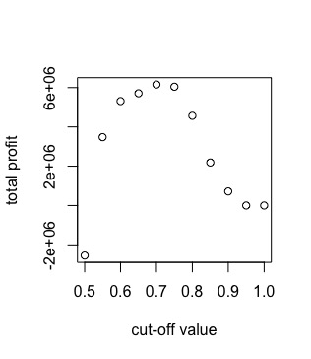
Cost Benefit Analysis was conducted to calculate the optimal cut-off value: 0.7
 | Actual 0 | Actual 1
Predict 0 | 3070 | 8297
Predict 1 | 4637 | 35280
Optimal Threshold: 0.7
Cut-off = 0.5
 | Actual 0 | Actual 1
Predict 0 | 6343 | 25975
Predict 1 | 1364 | 17602
Cut-off = 0.7
Notes:
References:
https://www.lendingclub.com/site/investing/solid-returns

Slide 30
Cost Benefit Analysis was conducted to calculate the optimal cut-off value: 0.7
Original Profit
Average Profit per Investor: $ -593
 | Actual 0 | Actual 1
Predict 0 | 6343 | 25975
Predict 1 | 1364 | 17602
After Prediction
Average Profit per Investor: $ 327
Notes:
References:
https://www.lendingclub.com/site/investing/solid-returns

Slide 31
Financial Benefit of our prediction project
For Investors
Reduce the risk of default and increase total profit
For Lending Club
Acquire more investors
Lending Club could increase its commission fee
Increasing its revenue
Notes:
References:
https://www.lendingclub.com/site/investing/solid-returns

Slide 32
Data Visualization
5
Mo

Slide 33

Scenario
Short term investment (36 months)
$5,000
Low Risk Tolerance
Positive Return

Slide 34

Scenario
Short term investment (36 months)
$5,000
Low Risk Tolerance
Positive Return
Long term investment (60 months)
$30,000
High Risk Tolerance
High Return

Slide 35
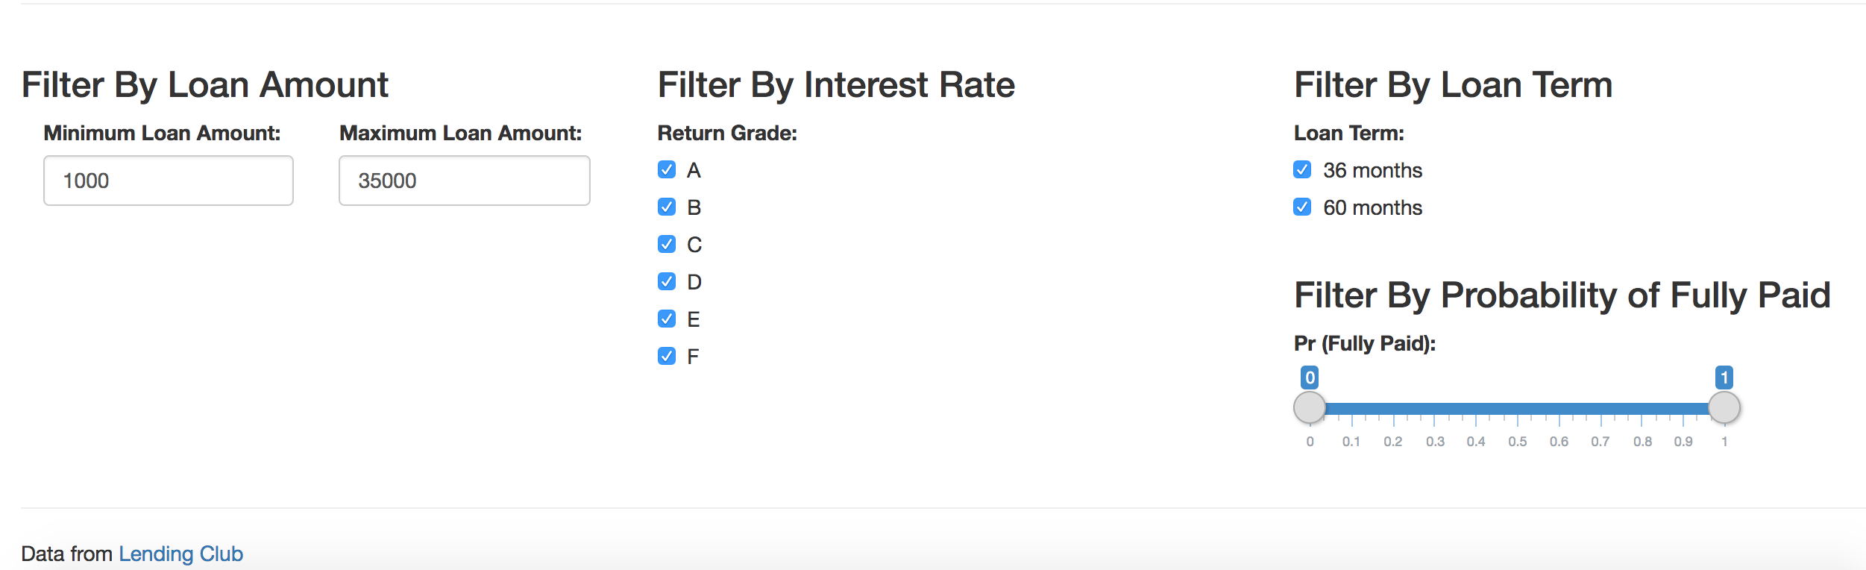
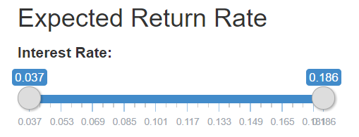
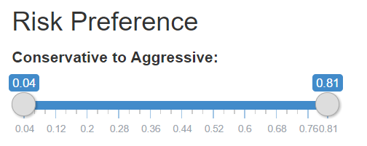
Shiny

Slide 36
What if we want to look at the data in a macro perspective, like…
FICO score & Average Loan Amount
Number of borrowers in every grade
Relationship between risk and return

Slide 37
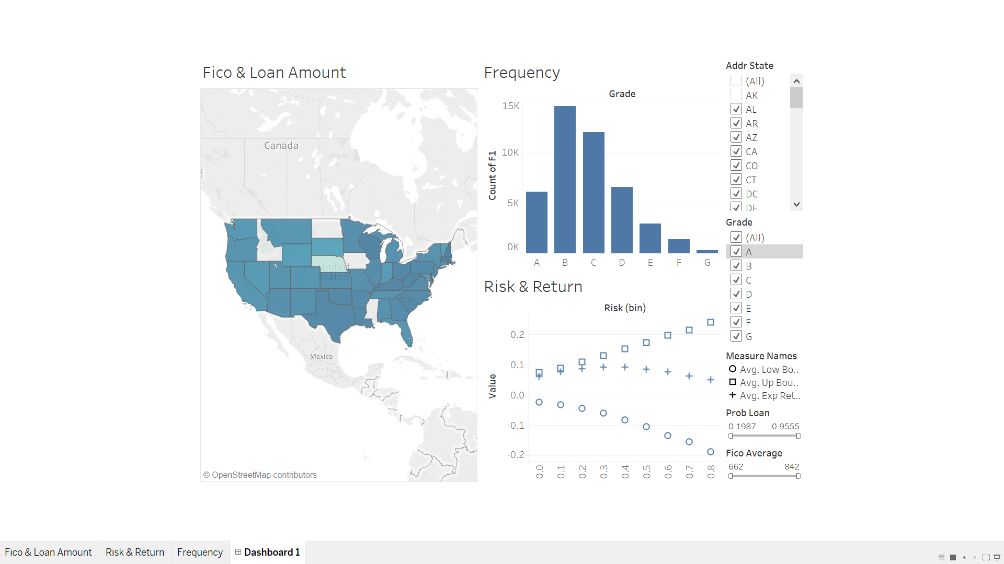
Tableau

Slide 38
Summary & Next Steps
6
Spencer

Slide 39
Summary of the project
Choice overloaded interface
Increasing loan delinquency rate
Lack of interest alignment
Gradient Boosting algorithm
Average Profit per Investor: from $ -593 to $ 327
Shiny app and Tableau
Notes:
References:
https://www.lendingclub.com/site/investing/solid-returns

Slide 40
Next Steps
Increasing loan delinquency rate
Lack of interest alignment
Choice overloaded interface
Gradient Boosting algorithm
Average Profit per Investor: from $ -593 to $ 327
Shiny app and Tableau
More advanced techniques
New business model
Integration
Notes:
References:
https://www.lendingclub.com/site/investing/solid-returns

Slide 41
THANKS!

Slide 42
Appendix
7

Slide 43
New Data was collected to calculate their probability of fully paid by running our model
Data
Collection
Data
Preprocessing
Outcome
Prediction
Date - 2016
Rows - 46526
Missing Values
Features Transformation
Run Gradient Boosting
Predict Loan Status Probability
Higher value (0-1) means
Higher Prob(fully paid)
Notes:
Support Vector Machine attempts to find a hyperplane (A hyperplane in an n-dimensional space is a n-1 dimensional subset of that space that divides the space into two disconnected parts. ) that divides two classes with the largest margin. The support vectors are the points right up against the margin of the decision hyperplane.

Slide 44
We could add regularization to reduce overfitting for the gradient boosting
 | AUC | Accuracy
Training | 0.71 | 0.79
Testing | 0.68 | 0.75
Reduce the magnitude of parameters to reduce overfitting
Protect from outliers that might skew coefficients drastically
Notes:
Regularization is a way for reducing overfitting in a flexible and tunable manner. Overfitting occurs when they are usually many features in the model, and the model fits training data so well that it could not fit other dataset. Therefore, one method to solve the problem is by reducing the number of features. But it is hard to pick since it might miss out some actually important features. So we use the second method by introducing Regularization. It will keep all the features, but reduce the magnitude of parameters. Because Having small values for parameter will be less prone to overfitting. The mechanism behind regularization is to add a penalty function to our cost function.

Slide 45
Missing values are dealt with cautiously
Except for those ‘real’ missing values, there are some cases where NULL(N/A) values stand for some certain situations of a loan. We deal with these missing values very cautiously to
Home_ownership: the home ownership status provided by the borrower during registration obtained from the credit report, values are: RENT, OWN, MORTGAGE, OTHER
None value means NO HOME, which could be treated as a case of home ownership.
Mths_sin_last_delinq: months since most recent revolving delinquency.
None value means NO DELINQUENCY RECORD, which could not be filled with 0. So we did some data transformation to solve the problem.
Notes:
References:
https://www.lendingclub.com/site/investing/solid-returns

Slide 46
We did feature transformations to serve for the models
Mths_sin_last_delinq: months since most recent revolving delinquency.
We used 84 months as a threshold value (84 months = 7 years, the time that social credit records get updated)
< 84 months: keeping the original values
> 84 months or NONE: replacing it with 84 months
Loan_status: current status of the loan
We used a binary variable to replace it so that classification algorithm could be applied
Default+Charged off+Late: 0
Fully paid+Current+In grace period: 1
Fico_range_low/Fico_range_high: The lower/upper boundary range the borrower’s FICO.
We found that there is always 4 points gap between the two variables.
Fico_range_avg = (Fico_range_low+Fico_range_high)/2
Notes:
References:
https://www.lendingclub.com/site/investing/solid-returns

Slide 47
IN TWO OR THREE COLUMNS
Yellow
Is the color of gold, butter and ripe lemons. In the spectrum of visible light, yellow is found between green and orange.
Blue
Is the colour of the clear sky and the deep sea. It is located between violet and green on the optical spectrum.
Red
Is the color of blood, and because of this it has historically been associated with sacrifice, danger and courage.

